Slide 1
ansible
Velocity training institute
Shantanu Mahajan (sr Engg Devops)

Slide 2
Introduction
To truly grasp the DevOps concept within an organization, you should understand a handful of essential primary disciplines.
These include coding, building, testing, packaging, release, configuration, and monitoring.
Each discipline comes with its own set of best practices.
Configuration management is important in DevOps because it helps you automate otherwise tedious tasks and allows an organization to increase agility.

Slide 3
What is configuration management?
In software development circles, configuration management refers to the process by which all environments hosting software are configured and maintained.
Every development pipeline requires multiple environments for multiple purposes – unit testing, integration testing, acceptance testing, load testing, system testing, end-user testing, etc.
These environments become increasingly complex as the testing moves towards pre-prod and prod environments.
Configuration management is an automated process that ensures the configuration of these environments is optimal.

Slide 4
What is configuration management?
Accurate configuration makes every resource – servers, networks, data centers, operating systems, IT assets, configuration files – function as they must to facilitate success.
These environments must be meticulously managed, and all configuration changes must be tracked to ensure that they are traceable.
Inadequate configuration management can lead to system outages, data breaches, and leaks.
Not to mention the fact that bad environments make for improper, incomplete, and shallow tests.

Slide 5
What is configuration management?
Using Configuration Management is imperative in DevOps infrastructures.
Remember, DevOps is about facilitating speed, accuracy, and efficiency.
Configuration Management helps to automate mundane maintenance tasks, which frees up dev time for actual programming.
This increases agility, both on the part of individual devs and the organization as a whole.
At this point, it would be correct to state that Configuration Management is fundamentally necessary for setting up a DevOps-driven framework.

Slide 6
Configuration management tool
Configuration management tools enable changes and deployments to be faster, repeatable, scalable, predictable, and able to maintain the desired state, which brings controlled assets into an expected state.
Types of configuration management tools:-
A. Pull based tools:- Chef, Puppet etc.
B. Push based tools:- Ansible, salt etc

Slide 7
Advantages of using CMT
Increased efficiency with a defined configuration process that provides control and improves visibility with tracking.
Cost reduction by having detailed knowledge of all the elements of the configuration which allows for unnecessary duplication to be avoided.
Your business will have greater agility and faster problem resolution, giving a better quality of service for your customers.
Enhanced system and process reliability through more rapid detection and correction of improper configurations that could negatively impact performance.
The ability to define and enforce formal policies and procedures that can help with process status monitoring and auditing.
More efficient change management that reduces the risk of product incompatibility or problems.
Faster restoration of your service if a process failure occurs. If you know the required state of the configuration then recovering the working configuration will be much quicker and easier.

Slide 8
Ansible
Ansible is an open-source software provisioning, configuration management, and application-deployment tool enabling infrastructure as code.
It runs on many Unix-like systems, and can configure both Unix-like systems as well as Microsoft Windows.
Ansible is a software tool that provides simple but powerful automation for cross-platform computer support.
It is primarily intended for IT professionals, who use it for application deployment, updates on workstations and servers, cloud provisioning, configuration management, intra-service orchestration, and nearly anything a systems administrator does on a weekly or daily basis.

Slide 9
Features of ansible
Based on an agent-less architecture (unlike Chef or Puppet).
Accessed mostly through SSH.
No custom security infrastructure is required.
Configurations (playbooks, modules etc.) written in the easy-to-use YML format.
Shipped with more than 250 built-in modules.
Full configuration management, orchestration, and deployment capability.
Ansible interacts with its clients either through playbooks or a command-line tool.

Slide 10
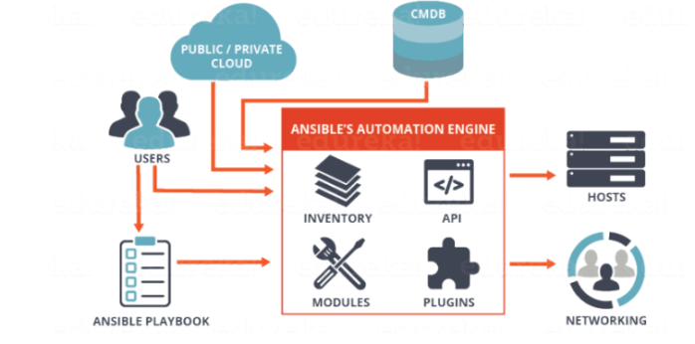
Ansible architecture

Slide 11
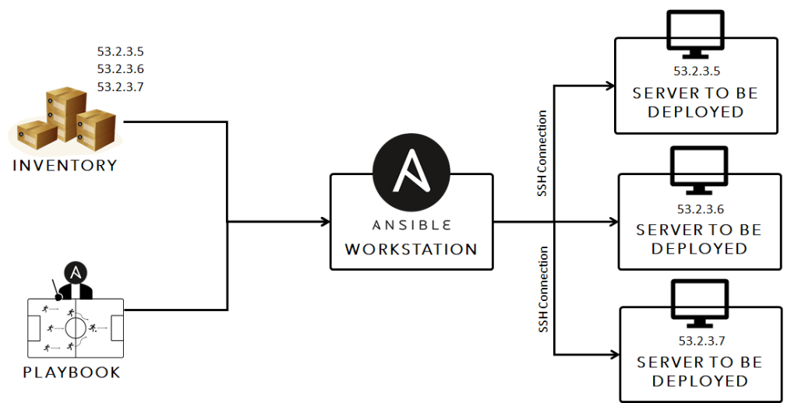
Ansible architecture

Slide 12
Ansible architecture components
Ansible runs as a server on just about anything: even a humble PC or laptop.
It has an inventory of hosts, modules, and playbooks that define various automation tasks.
Ansible server:- the machine on which ansible is installed and from which all the tasks and playbooks will be run.
Module:- basically it’s a command or a set of similar commands which are meant to be executed on the client side. There are hundreds of predefined modules which we can use or create by ourselves.
Task:- Tasks are actions carried out by playbooks. Or you can say any procedure that has to be completed.

Slide 13
Playbooks
In most cases – especially in enterprise environments – you should use Ansible playbooks.
A playbook is where you define how to apply policies, declare configurations, orchestrate steps and launch tasks either synchronously or asynchronously on your servers.
Each playbook is composed of one or more “plays”.
Playbooks are normally maintained and managed in a version control system like Git. They are expressed in YAML (Yet Another Markup Language).

Slide 14
Ansible architecture components
Roles
A role is the Ansible way of bundling automation content and making it reusable.
Roles are organizational components that can be assigned to a set of hosts to organize tasks.
Therefore, instead of creating a monolithic playbook, we can create multiple roles, with each role assigned to complete a unit of work.
For example: a webserver role can be defined to install Apache and Varnish on a specified group of servers.
A way of organizing tasks and related files to be later called in a playbook

Slide 15
Ansible architecture components
Fact:- information fetched from the client system from the global variables with the gather-facts operation
Inventory :-
The “inventory” is a configuration file where you define the host information. In the above /etc/ansible/hosts example, we declared two servers under test-hosts.
Play:-
Playbooks contain plays. Plays are essentially groups of tasks that are performed on defined hosts to enforce your defined functions. Each play must specify a host or group of hosts
Handlers:-
Handlers are similar to tasks except that a handler will be executed only when it is called by an event. For example, a handler that will start the httpd service after a task installed httpd. The handler is called by the [notify] directive. Important: the name of the notify directive and the handler must be the same.

Slide 16
Ansible architecture components
Notifier:-
Section attributed to a task which calls a handler if the output is changed.
Hosts:-
Nodes which are automated by ansible
Variables:-
As the name suggests, you can include custom-made variables in your playbooks. Variables can be defined in five different ways:

Slide 17
Sample playbook
## PLAYBOOK TO INSTALL AND CONFIGURE APACHE HTTP ON Servers
- hosts: all
tasks:
- name: Install Apache httpd
yum: pkg=httpd state=installed
notify:
- Start Httpd
handlers:
- name: Start httpd
service: name=httpd state=started

